Slide 1
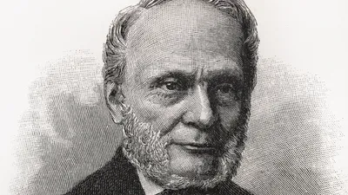
Gibbs Free Energy and Entropy
Why chemical reactions really happen
Josiah Willard Gibbs was known for discovering the concept of free energy as well as rocking the most awesome beard in early 20th century Connecticut!

Slide 2
Thermodynamic Favorability
In for a reaction to take place, it needs to be thermodynamically-favorable (referred to as “spontaneous” in the old days).
If something is thermodynamically-favorable, this means that it will tend to take place spontaneously (though perhaps over a long period of time).
ΔH_{rxn} by itself isn’t enough to tell if a reaction is thermodynamically favorable.

Slide 3
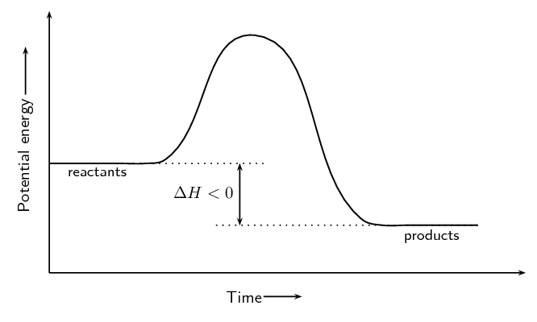
Two examples of thermodynamically-favorable reactions
When the reaction takes place, ΔH is negative, showing that the system has given off energy (gotten hot)
Example 1: The combustion of isopropanol in oxygen
2 C₃H₇OH + O₂ → 6 CO₂ + 8 H₂O
Does this mean that exothermic means “thermodynamically favorable?”

Slide 4
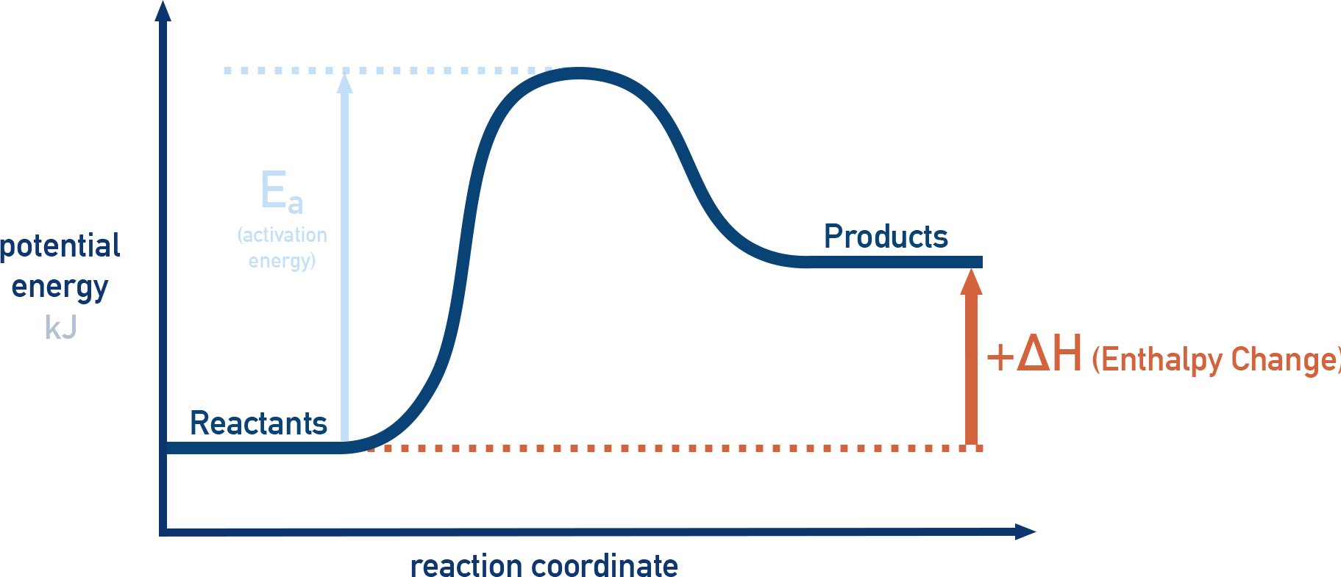
Example 2: Dissolving ammonium nitrate
NH₄NO_{3(s)} → NH₄⁺(aq) + NO₃⁻(aq)
When the reaction has taken place, the reaction had a positive heat of enthalpy. As a result, the reaction is endothermic and gets cold.
Does this mean that “endothermic” means “thermodynamically-favorable?”

Slide 5

The first reaction was exothermic and thermodynamically- favorable.
The second reaction was endothermic and thermodynamically-favorable.
Since ΔH can’t always tell us whether a reaction is thermodynamically-favorable, we need another way of calculating this!
We call this term...

Slide 6

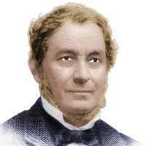
Gibbs Free Energy (G)
Fun fact about Josiah Gibbs: His eyes gave off such a piercing stare that he could hypnotize people from a distance of 50 meters.
You should probably look away from this picture.

Slide 7

What is Gibbs Free Energy (G)?
Free energy is the amount of energy that’s available to do useful work in a reaction.
Think of cooking a pizza. The free energy is the energy that goes into cooking the pizza and the leftover heat is the rest of the energy.

Slide 8

What does Gibbs free energy have to do with thermodynamic favorability?
If the free energy of a system decreases during some process (i.e. ΔG is negative), the reaction will be thermodynamically-favored.
If the free energy of a system increases during some process (i.e. ΔG is positive), the reaction will be thermodynamically-disfavored.
If ΔG < 0, the reaction is favored.
If ΔG > 0, it is not.

Slide 9
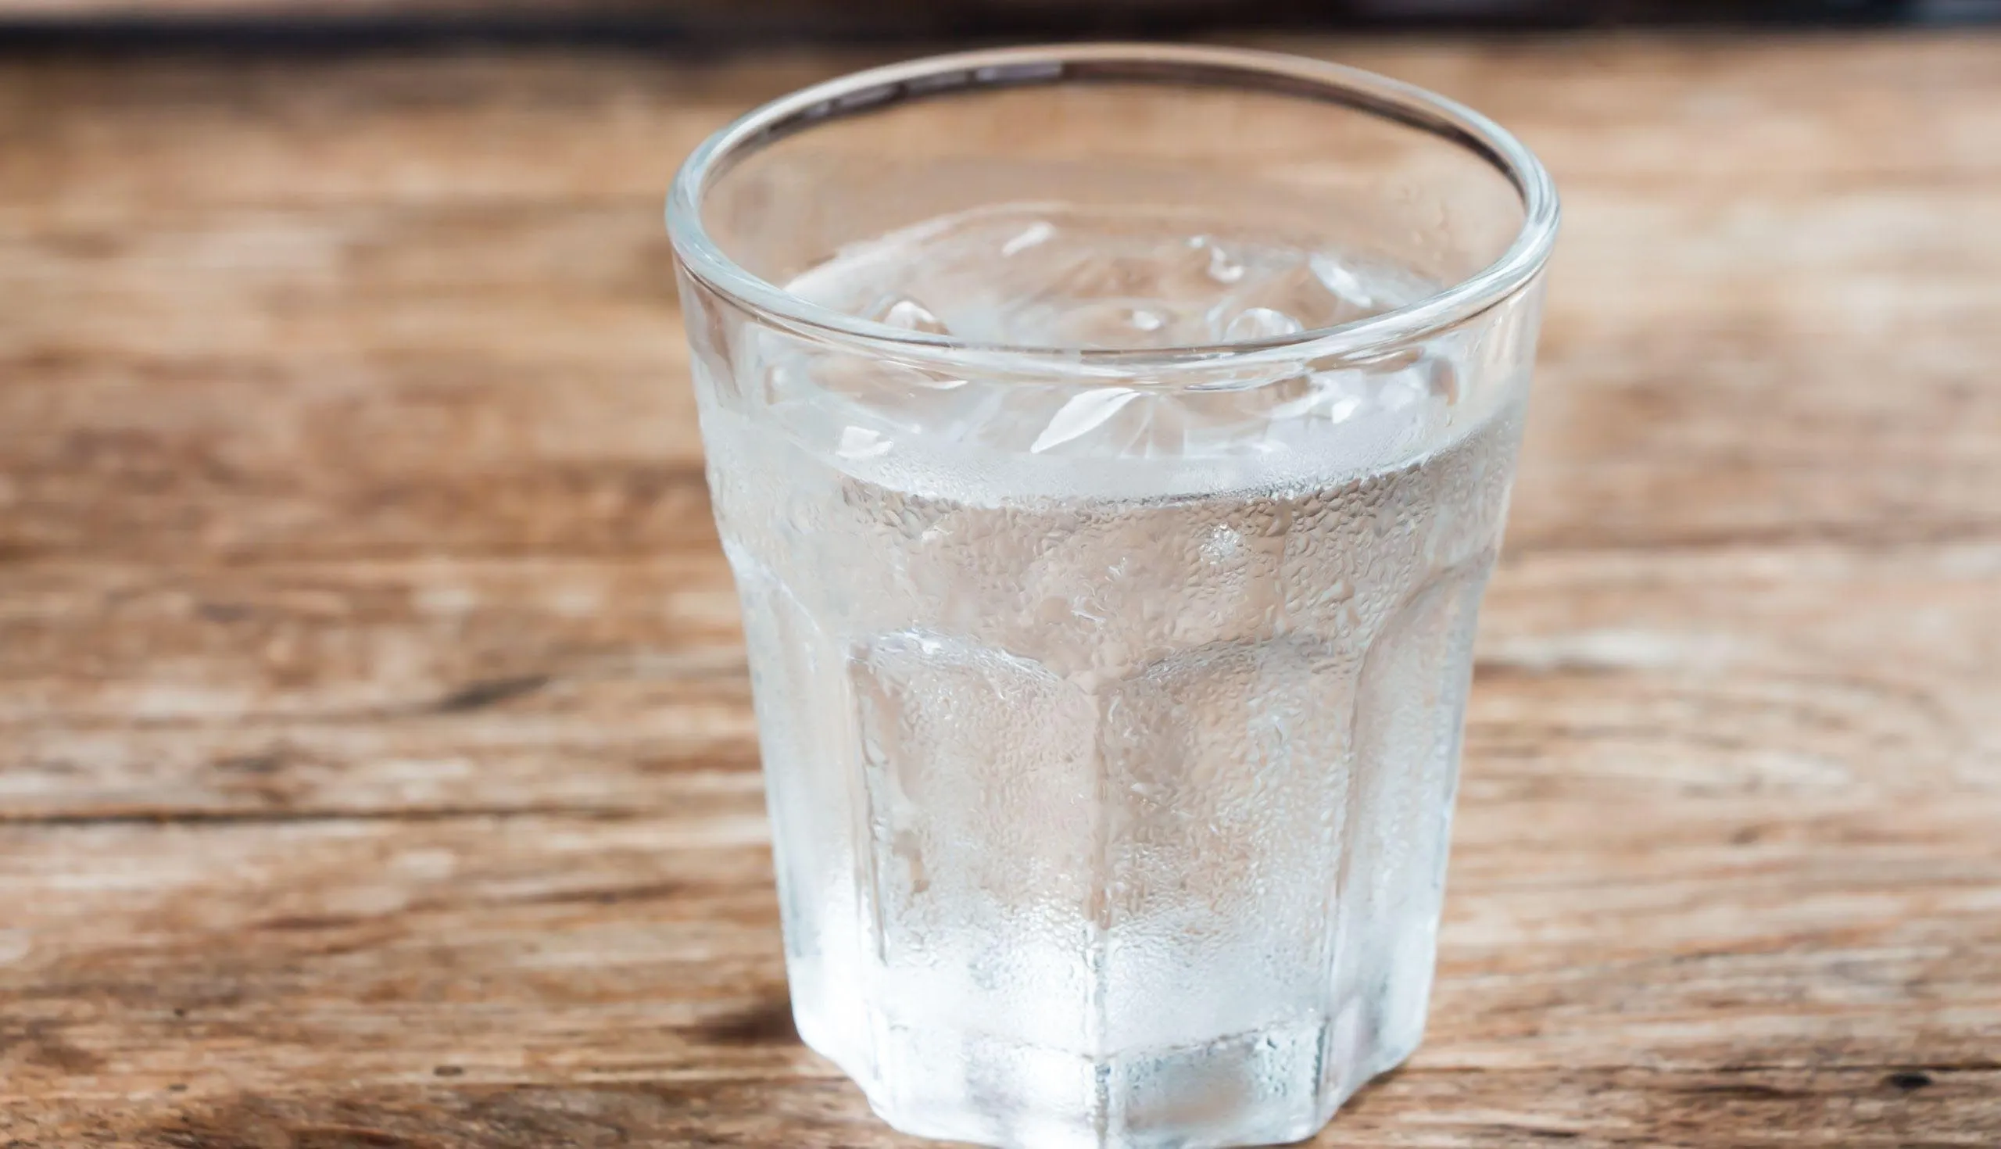
So, how is ΔG different from ΔH?
It includes a term called entropy (S)
Entropy is a measure of the disorder in a system.
Example: If you have a piece of ice melting in a glass of water, the ice starts off with low entropy (the water molecules are all locked in place) and ends at higher entropy (the water molecules are all over the place).
Behold! Entropy!

Slide 10

Entropy, Part 2: 2nd Law of Thermodynamics
1st Law of Thermodynamics: Energy is neither created nor destroyed in any process.
2nd Law of Thermodynamics: The entropy of the universe will increase anytime something happens.
No matter what the process, the entropy of the universe always goes up. Even if it looks like entropy is decreasing, (you clean up a bunch of LEGO), the amount of entropy generated by doing it more than accounts for it.

Slide 11

What Changes Entropy?
Processes and their effects on △S:
Freezing has a negative entropy.
Condensing has a negative entropy.
Boiling has a positive entropy.
Melting has a positive entropy.
Evaporation has a positive entropy.
General rules for reaction entropy:
Reactions that result in phase changes affect entropy.
Reactions that result in the formation of lots of products increases entropy, while those that result in the formation of fewer products decreases entropy.

Slide 12
Since both ΔH and ΔS play a role in whether or not a reaction will take place, any determination of whether a reaction is thermodynamically-favored needs to take both enthalpy (H) and entropy (S) into account.

Slide 13

So, how do we know if something is thermodynamically-favored? Math!
To find out if a reaction is thermodynamically favored, we need to know both ΔH and ΔS to find ΔG for the reaction and then use the equation:
ΔG = ΔH – TΔS
Where
ΔG = Gibbs free energy (tells us whether something is thermodynamically- favored).
ΔH = change in enthalpy for the reaction.
ΔS = the change in entropy for the reaction.
T = temperature in K.
If ΔG if negative, the reaction is thermodynamically-favored.
If ΔG is positive, it is not thermodynamically-favored.

Slide 14

An interesting feature of the equation
ΔG = ΔH - TΔS
The term TΔS implies that the contribution of ΔS depends on temperature.
This, in turn, tells us that ΔG will depend on the temperature at which the reaction is conducted.
As a result, a reaction that is thermodynamically-favored at one temperature may not be thermodynamically-favored at another.
Something else that’s interesting: The Watts Towers in Los Angeles

Slide 15
Sample problem:
Is the condensation of water a thermodynamically-favored process at a temperature of 298 K?
ΔHº = -44 kJ/mol
ΔSº = -119 J/mol.K
The big equation: ΔG = ΔH - TΔS
H₂O_{(g)} → H₂O_{(l)}
A handy reminder:
If ΔG is negative, the process is thermodynamically-favored.
If ΔG is positive, it is not thermodynamically-favored.

Slide 16

Let’s check our work!
ΔG = ΔH – TΔS
ΔG = -44 kJ/mol – 298K(-0.119 J/mol.K)
ΔG = -8.5 kJ/mol
This process is thermodynamically-favored under these conditions because ΔG is negative!
Common sense check: The process we’re looking at involves steam condensing to liquid water. Given what you know of the typical state of water at room temperature, this shouldn’t be too surprising.

Slide 17

What if we do this process at 500 K instead of 298 K?
ΔG = ΔH – TΔS
ΔG = -44 kJ/mol – 500K (-0.188 J/mol.K)
ΔG = +15.4 KJ/mol
At 500 K, ΔG is positive so this process is no longer
thermodynamically-favored.
Temperature makes a difference in determining whether a reaction is thermodynamically-favored!

Slide 18

Another example:
CaCO_{3(s)} → CaO_{(s)} + CO_{2(g)}
At 298 K:
ΔHº = 178.3 kJ/mol
ΔSº = 160.5 J/mol.K
What is the value of ΔG for this reaction?
Is this reaction thermodynamically-favorable or unfavorable under these conditions?

Slide 19

What We’ve Learned
The value of ΔG determines whether a process is thermodynamically-favored.
Entropy is a measure of the disorder in a system.
The 2nd law of thermodynamics: The entropy of the universe always increases.
ΔG = ΔH - TΔS

