Slide 1
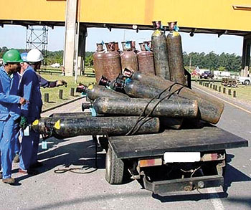
Gas Laws
Pretty much what it sounds like
In springtime, the gas cylinders are finally ready for harvesting.

Slide 2
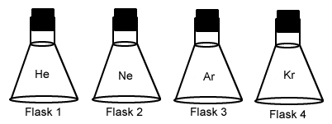
Why do gases behave the way they do?
Because of the kinetic molecular theory. We talked about this already. If you’ve forgotten, go have a look at the PowerPoint I gave you a few days ago.
This is not a particularly enlightening diagram.

Slide 3
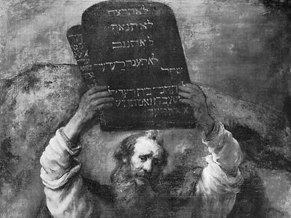
But how do gases behave?
There are a number of gas laws that describe the behavior of gases. These gas laws use the kinetic molecular theory of gases as the basis for understanding the specific behaviors of gases.
Believe it or not, you probably already understand how gases behave.
These laws are more important, but less easily explained by the kinetic molecular theory of gases.

Slide 4
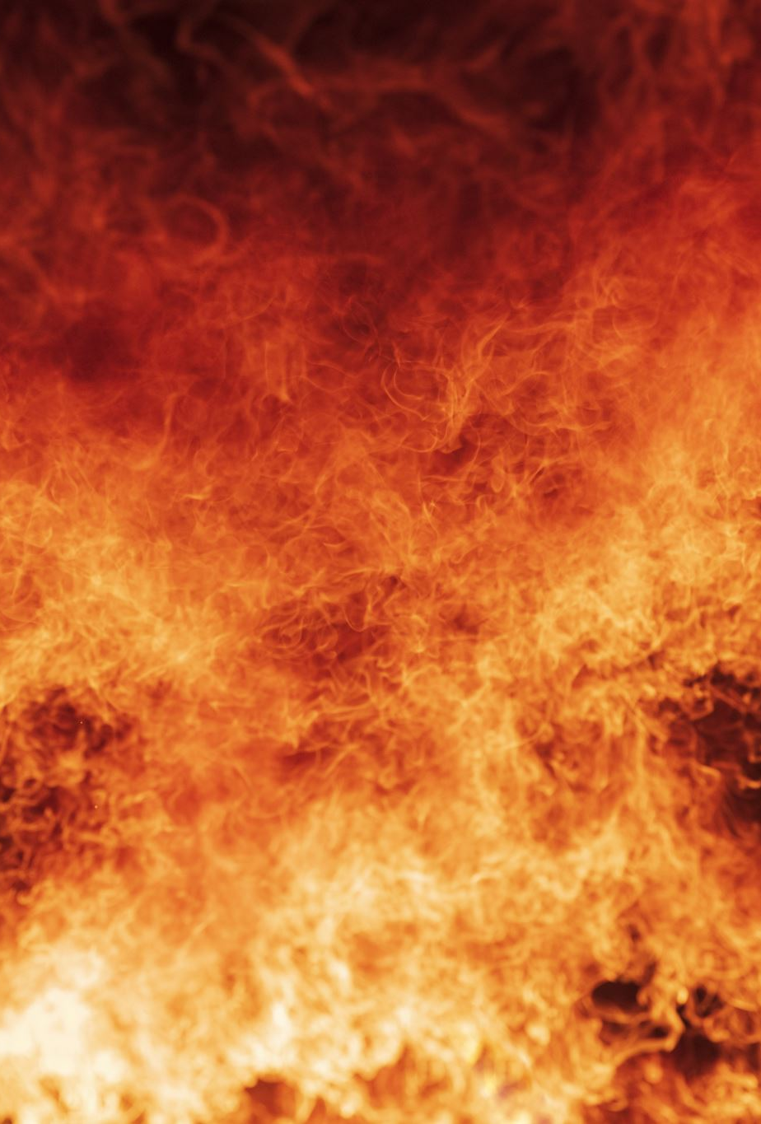
Some gas laws describe how gases change when their conditions are manipulated:
These gas laws describe what happens to the pressure, temperature, and/or volume of a gas when you change the other variables.
They don’t say anything about the gas by itself, only about the conditions of the gas when you change its environment.

Slide 5
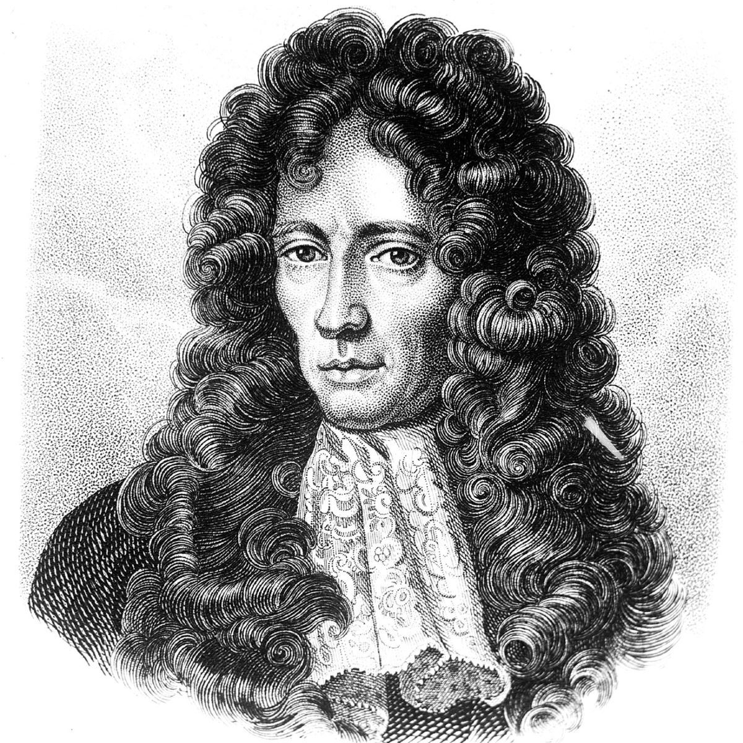
Boyle’s Law: P₁V₁ = P₂V₂
In human terms: If you push on a gas, it gets squished.
In fancy science terms: The pressure and volume of a gas are inversely proportional to one another.
Little-known historical
fact: Robert Boyle was
the original bassist of
rocksupergroup Queen.
Why?
The kinetic molecular theory of gases says that there’s a lot of space between gas molecules. When you add pressure, it squishes them more tightly together.
This works the other way: If you decrease the size of a container in which you have a gas, the pressure increases. This is because the gas particles hit the sides of the container more frequently.

Slide 6
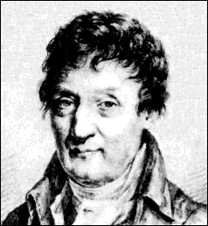
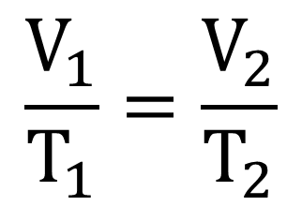
Charles’s Law:
Apparently, Jacques Charles forgot it was picture day
In human terms: If you heat up a gas, it gets bigger
In fancy science terms: The volume of a gas is proportional to its temperature
Why?
If you heat a gas, the molecules of the gas will move faster and have more energy.
As a result, the molecules can get away from each other more effectively.
This makes the gas expand in size.

Slide 7
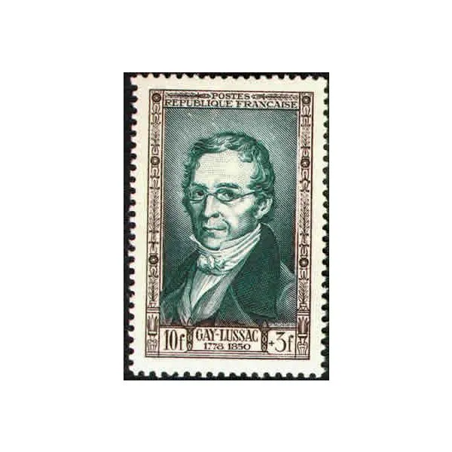
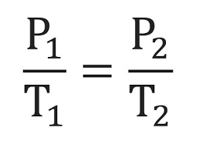
Gay-Lussac’s Law:
Human terms: If you heat a gas, the pressure goes up.
Fancy science terms: The pressure and temperature of a gas are directly proportional to each other.
Gay-Lussac spent most of his later years modeling for stamps.
Why?
If you increase the temperature of a gas, the molecules go more quickly and hit the sides of the container harder.
If the sides of the container can’t move, this leads to higher pressure.

Slide 8
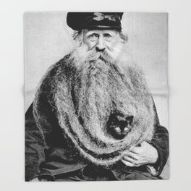
We could remember all of those individual laws, but let’s be honest, we don’t want to.
As a result, we will combine them.
This combined gas law will be called the “combined gas law”
This is the one you actually need to know.
You can forget the other three now.
If this gas law had actually been invented by a guy with the last name “Combined”, this is what I think he’d look like.

Slide 9
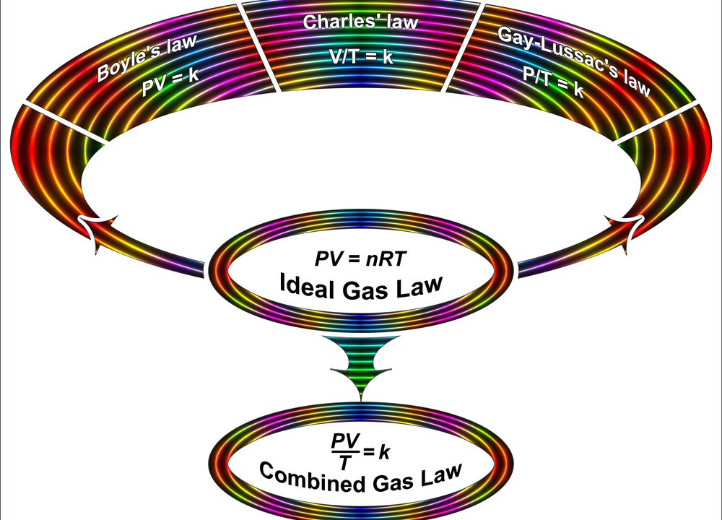
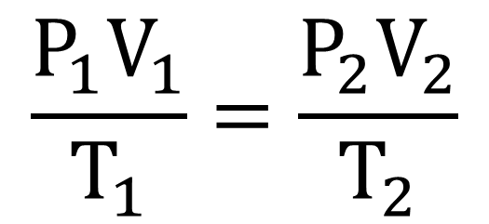
The Combined Gas Law
Extremely unhelpful image. Forget I mentioned it.
What it means: The pressure, volume, and temperature of a gas are all related to each other by this expression.
P₂ = final pressure of gas once a change has been made
V₂ = final volume of gas once a change has been made
T₂ = final temperature of gas
once a change has been made
P₁ = initial pressure of gas
V₁ = initial volume of gas
T₁ = initial temperature of gas
(in Kelvin, not degrees C)
(in K!)

Slide 10
An example:
I’ve got a balloon full of oxygen. If the initial pressure inside the balloon is 1.1 atm, the initial volume is 3.5 L, and the initial temperature is 290 K, what will the volume of the balloon be if I increase the pressure to 1.2 atm and the temperature to 311 K?
Answer (part 1): Let’s figure out what our variables are
P₁ is 1.1 atm, because that was the initial pressure in the balloon
V₁ is 3.5 L, because that was the initial volume of the balloon
T₁ is 290 K, because that was the initial temperature of the balloon
P₂ is 1.2 atm, because that was the pressure of the balloon after the change
V₂ is unknown. This is what we’re solving for
T₂ is 311 K, because that’s the pressure of the balloon after the change

Slide 11
Now, let’s put these variables into the combined gas law:
(1.1 atm)(3.5 L) (1.2 atm)V₂
(290 K) (311 K)
=
P₁ is 1.1 atm, because that was the initial pressure in the balloon
V₁ is 3.5 L, because that was the initial volume of the balloon
T₁ is 290 K, because that was the initial temperature of the balloon
P₂ is 1.2 atm, because that was the pressure of the balloon after the change
V₂ is unknown. This is what we’re solving for
T₂ is 311 K, because that’s the pressure of the balloon after the change

Slide 12


Solving for V₂, we find the final volume:
(1.1 atm)(3.5 L) (1.2 atm)V₂
₌
(290 K) (311 K)
V₂ = 3.4 L
To get business, this clown’s business card specifically mentions that he’s not a serial killer.

Slide 13
What happens if we don’t change two of the variables?
For example, let’s solve this problem:
If I have 45 liters of a gas at a pressure of 1.0 atm, what will the volume of the gas be if I increase the pressure of the gas to 1.8 atm?
(1.0 atm)(45 L) (1.8 atm)V₂
₌
T₁ T₂
We’ve got three unknowns! Uh oh!

Slide 14
Actually, it’s not a big deal
If the same variable is unknown on both sides of the equation, we’ll just assume it remained the same and ignore it!
(1.0 atm)(45 L) (1.8 atm)V₂
₌
T₁ T₂
We got rid of T₁ and T₂ because they were both unknown.
(1.0 atm)(45 L) = (1.8 atm)V₂
V₂ = 25 L

Slide 15

Leaving the combined gas law behind…

Slide 16

Let’s talk about what happens if we don’t change any variables at all. What happens if we want to know the conditions of several moles of gas on their own?

Slide 17
For this, we have the ideal gas law:
PV = nRT
P = pressure
V = volume (in liters)
n = number of moles of gas
R = ideal gas constant (which I’ll always give you)
  If pressure is in kPa, it’s 8.314 L Kpa/mol K
  If pressure is in atm, it’s 0.08206 L atm/mol K
T = temperature
IN KELVIN
K = degrees C + 273

Slide 18
Let’s see if this makes sense!
Let’s take a closer look at this gas law and see if it makes intuitive sense. Here are a couple of ways to do this:
nRT
V
nRT
P
P =
V =

Slide 19
A practice problem:
If I have 2.5 moles of oxygen at a temperature of 218 K and a pressure of 0.75 atm, what will the volume of the gas be?
PV = nRT
(0.75 atm) V = (2.5 mol) (0.08206 Latm/molK)(218 K)
V = 59.6 L

Slide 20
What if I don’t know what gas law to use?
Use the combined gas law if:
The question suggests that the conditions of a gas (P, V, T) have changed.
Moles or grams aren’t mentioned.
Use the ideal gas law if:
The question mentions moles or grams
There is no implication that any of the variables have changed.
Example: How many grams of gas are in a 12 L container at a temperature of 300 K, a volume of 5.0 L, and a pressure of 8.8 atm?
Example: I have a gas at a pressure of 4.5 atm and a temperature of 25 degrees C. If I increase the temperature to 125 degrees C, what will the new pressure of the gas be?

